Slide 1
Giving Electronically Is Easy Peasy

Slide 2
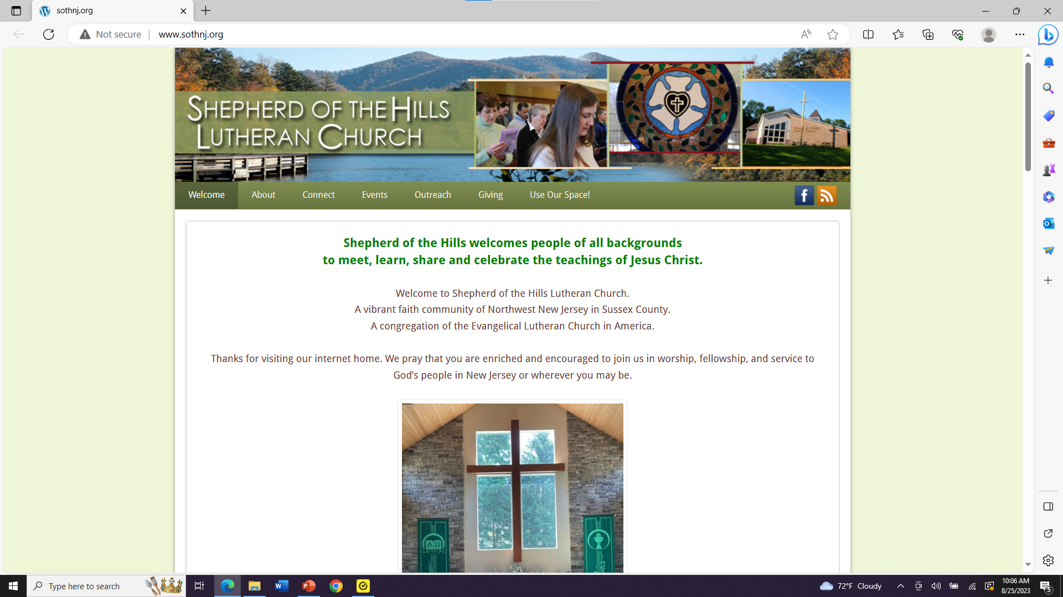
Go to our home page at: www.sothnj.org
You’ll see This Screen:
Now Click
“Giving”

Slide 3
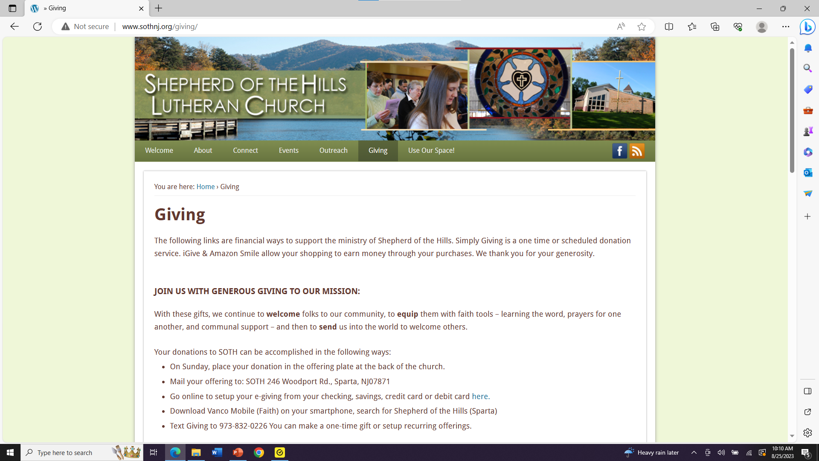
Now Click on the word “here”
(after the word “Debit Card”)

Slide 4
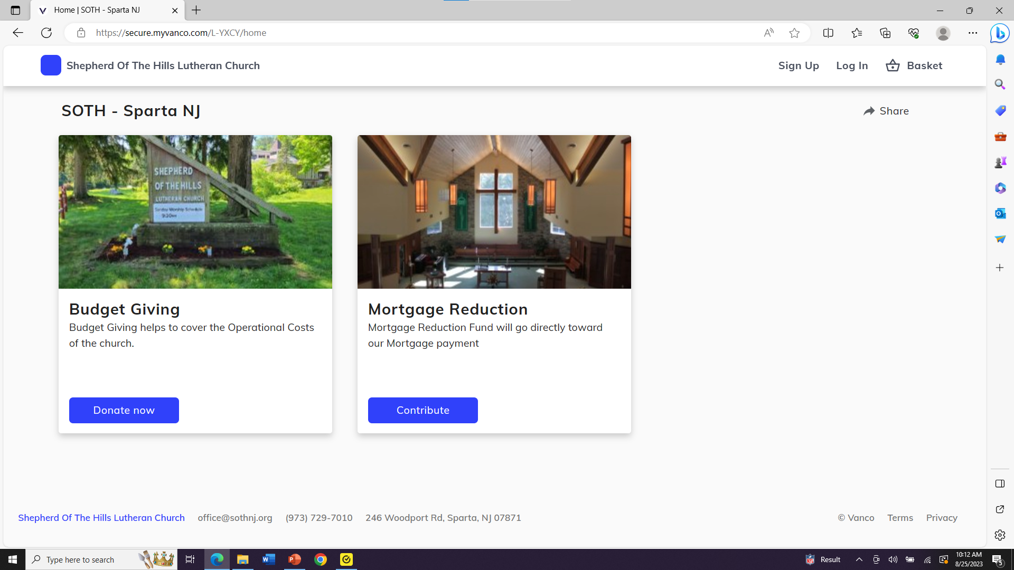
Choose “Budget Giving”
And click “Donate Now”

Slide 5
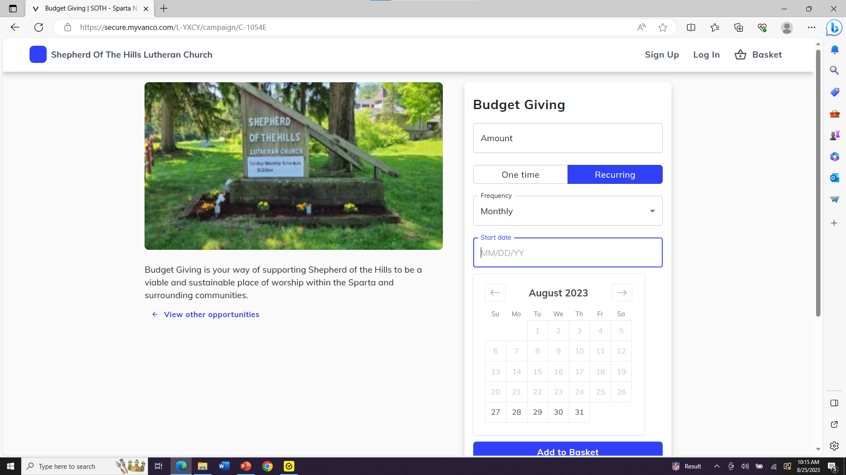
Complete the Information
2. Then click “Add to Basket”

Slide 6
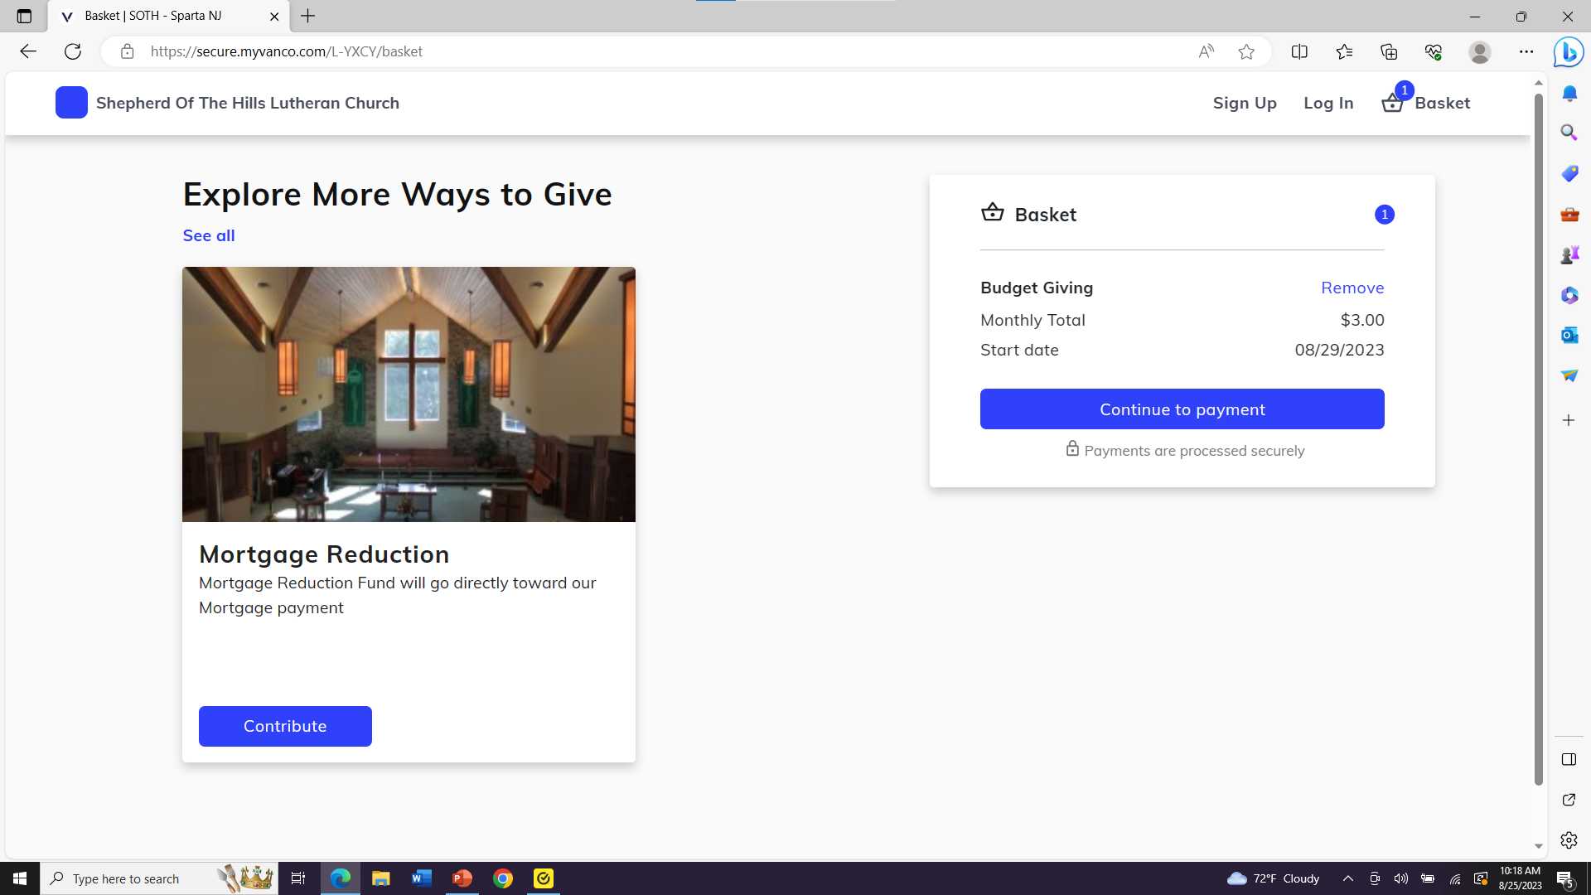
You’ll see this window summarizing your donation, then click:
“Continue to Payment”
You can then set up a new account or make
modifications to your existing account !

Slide 7
You Did It! Easy Peasy !
Thank you for Supporting
Shepherd of the Hills!

